Slide 1


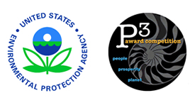
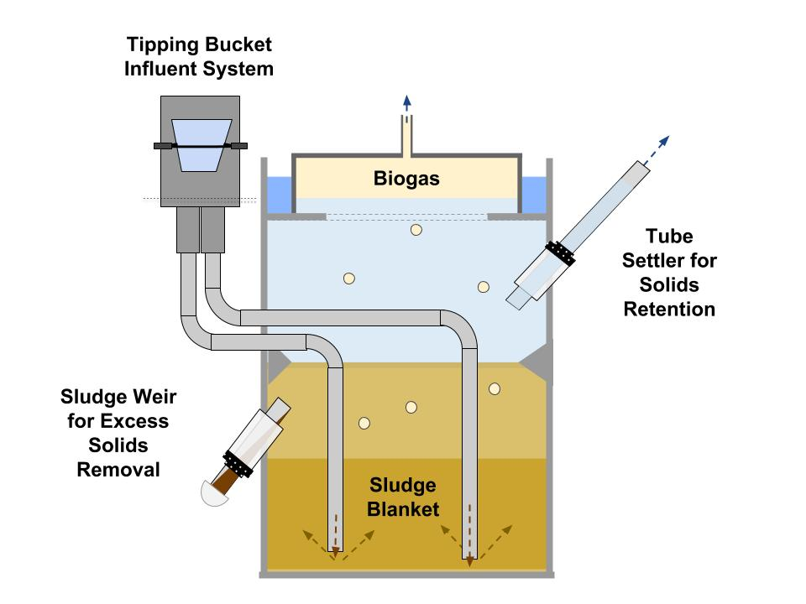
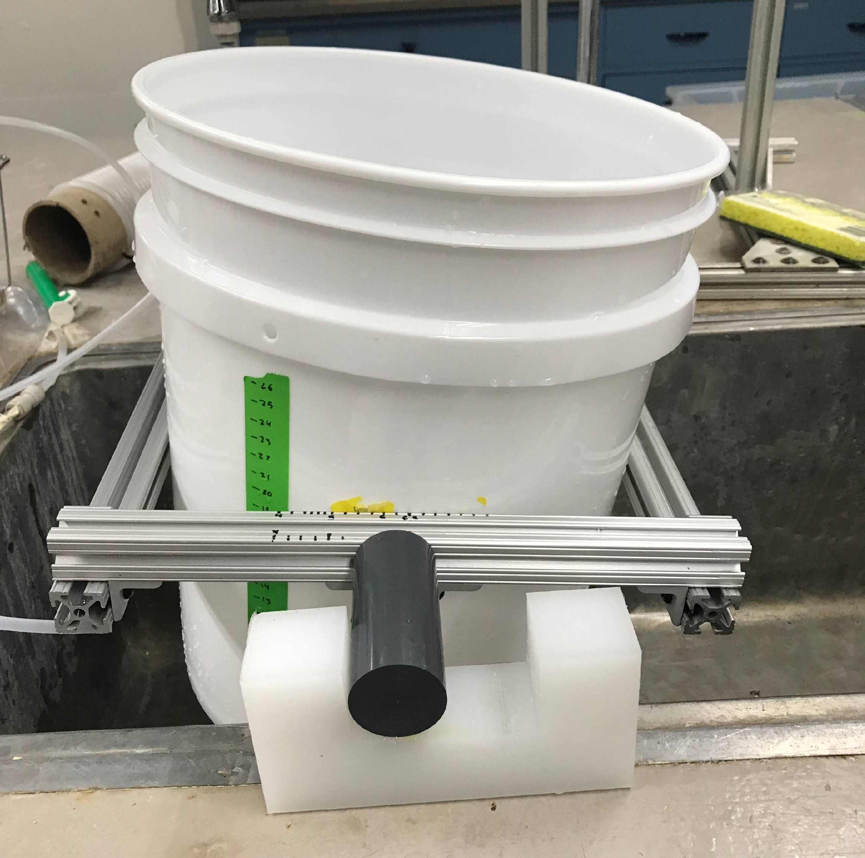
Climate and Community Friendly Wastewater
Treatment: Gravity-Powered UASB Reactors
Ananya Gangadhar¹, Ian Cullings¹, Zac Chen¹, Ruth Richardson^{1,2}
AguaClara Cornell, Cornell University Department of Civil and Environmental Engineering
Introduction
AguaClara Cornell is a student engineering group researching, inventing, designing, and implementing new water treatment technologies to provide clean water on tap.
While AguaClara Cornell has previously focused primarily on water treatment technologies, a large need has been identified for sustainable, community scale wastewater treatment systems. Around 80% of the wastewater in the world is released into the environment without any treatment. Discharge of untreated wastewater can cause negative health and environmental effects.
Upflow Anaerobic Sludge Blanket (UASB) reactors are used for primary biological wastewater treatment in many countries. However, conventional UASB reactors require large infrastructure and power inputs. AguaClara Cornell has focused on reinventing the design of these systems to provide low-cost, sustainable wastewater treatment infrastructure for target communities.
UASB Reactors
UASB reactors treat wastewater through anaerobic digestion of organic matter. The anaerobic bacteria in the sludge blanket form large clusters called granules which conglomerate to form a settled bed. These bacteria are primarily methanogenic, which means that they release methane as a by-product during breakdown of organics.
Wastewater enters the UASB reactor from the bottom and flows upwards through the sludge blanket, where contaminants are broken down. Organics in the wastewater provide energy for these bacteria, which grow larger and more efficient colonies. The methane produced rises through the reactor and is captured in the lid. Clean water flows out of the sludge blanket and leaves through an effluent line.
Effluent waste is carried to secondary treatment for excess nutrient removal, and then chlorinated to remove pathogens. Biogas is captured in the lid and utilized as a valuable product for communities. It can be pressurized and used for heating, cooking or energy generation.
Design Innovations
Gravity Power
Typical wastewater treatment systems, including large scale UASBs, use pumps to power water through the reactor, which requires electricity. The AguaClara design is entirely gravity powered, using differences in water elevations to power flow through the system.
Influent System
To make a gravity-powered reactor, the UASB influent system had to be altered. In the AguaClara design, a tipping bucket system, pictured below, regulates flow, providing enough hydraulic potential per pulse to force flow through the system, and fluidize the bed.
Biogas Capture
The traditional UASB biogas capture design had to be redesigned to accommodate lower and more irregular flows of biogas. Biogas is captured in gas bags, with flow regulated through valves. These bags can easily be swapped out and attached to a stove for cooking .
Anticipated Outcomes
The goal of this project is to implement an efficient wastewater treatment system in small, rural communities. The focus of this design is to lower cost, simplify components, and create a system that can be easily fabricated and implemented abroad.
This semester, the team will focus on finalizing the UASB design and then fabricating a pilot reactor. The UASB prototype will be tested at the Ithaca Area Wastewater Treatment Facility. This will allow the team to gain crucial insights into improving the reactor design before full implementation in Honduras.
Acknowledgements
Research funded
through a Phase I
Grant from the EPA
People, Prosperity,
and the Environment
(P3) award.
Special thanks to Dr. Monroe Weber Shirk and Dr. Ruth Richardson, as well as Ed Gottlieb from the Ithaca Area Wastewater Treatment Facility for support and guidance.
Aim
The UASB subteam is one of 25 subteams at AguaClara Cornell conducting research on water treatment technologies. The team is focused on 4 main goals:
Rethink traditional wastewater treatment to design a new solution for an old problem in the Global South.
Design a prefabricated, gravity-driven, pilot-scale Upflow Anaerobic Sludge Blanket (UASB) reactor.
Maximize biogas capture efficiency to provide clean fuel for rural communities.
Test pilot UASB reactor at local wastewater treatment plant and determine reactor efficiency and design improvements.
Contact Us
Follow our progress and learn more about the project through GitHub at https://github.com/AguaClara/UASB.
To learn more about AguaClara, contact cuaguaclara@cornell.edu, or find us on social media.
Figure 1: The proposed UASB system, with design components highlighted
Figure 2: A model of the tipping bucket system used for determining optimal pivot locations

